Slide 1
Karim Akmal Ashour id:223309 Summary of the LCM code
To find the LCM of two numbers, we can use the formula: LCM (a, b) = (a * b) / GCD (a, b), where GCD (a, b) is the greatest common divisor of a and b
To find the GCD of two numbers, we can use the Euclidean algorithm, which is based on the observation that GCD (a, b) = GCD (b, a mod b), where a mod b is the remainder of dividing a by b.

Slide 2
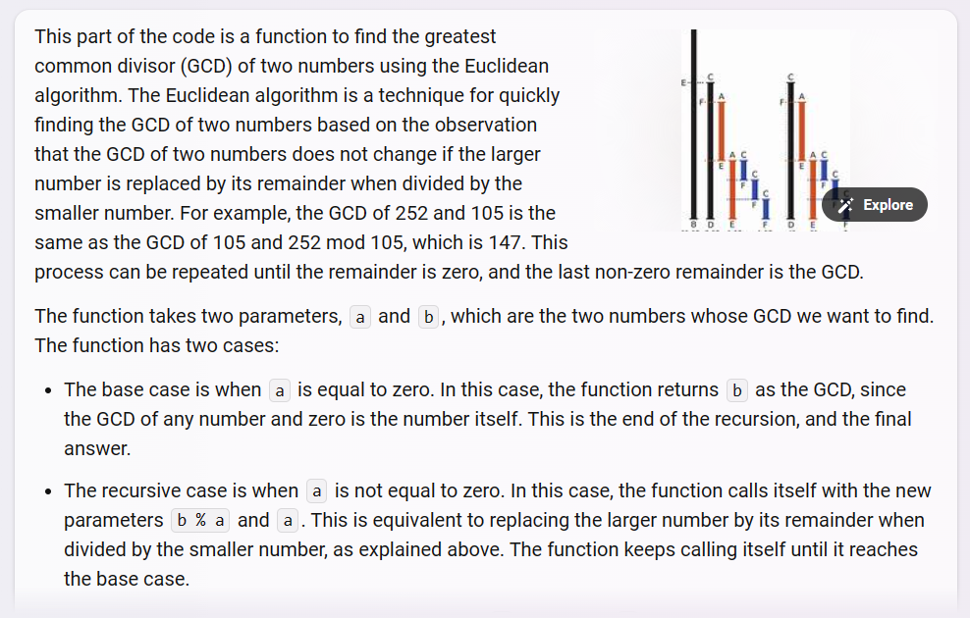
Part 1- the means of GCD

Slide 3
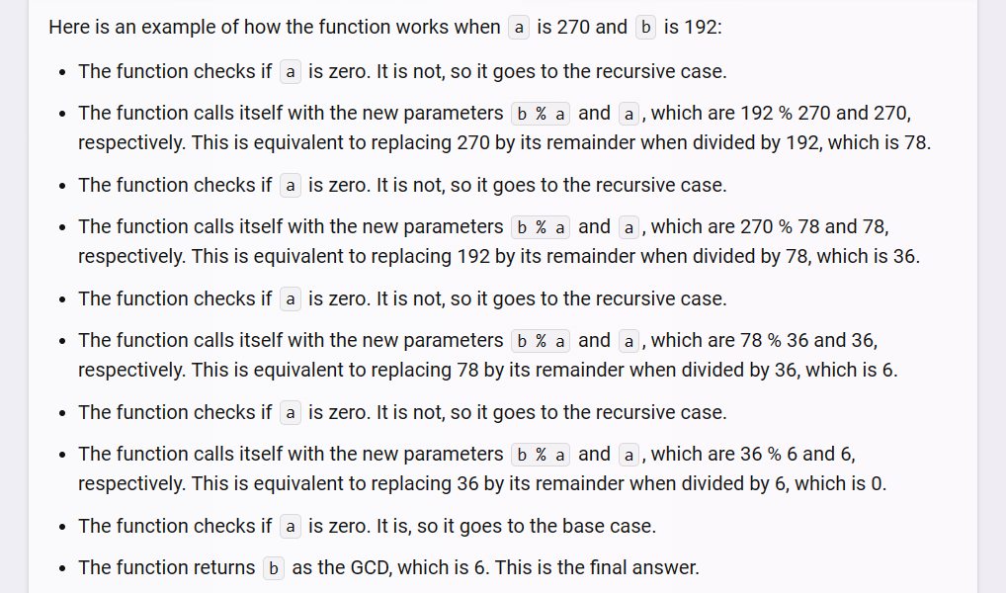
Part 2

Slide 4
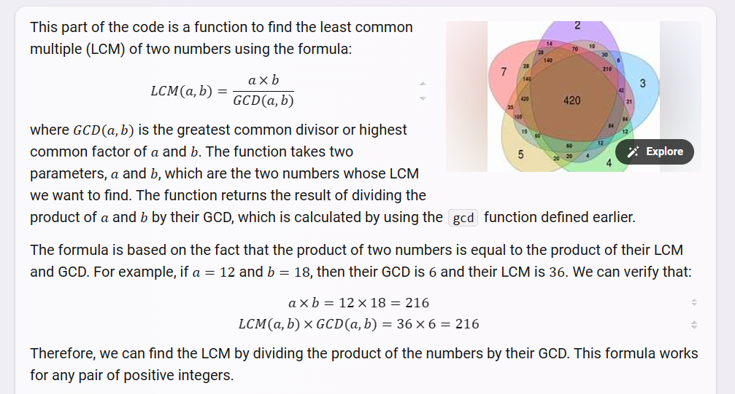
Part 3

Slide 5
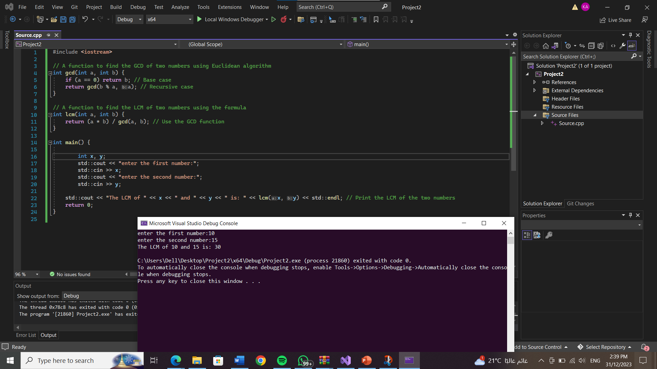
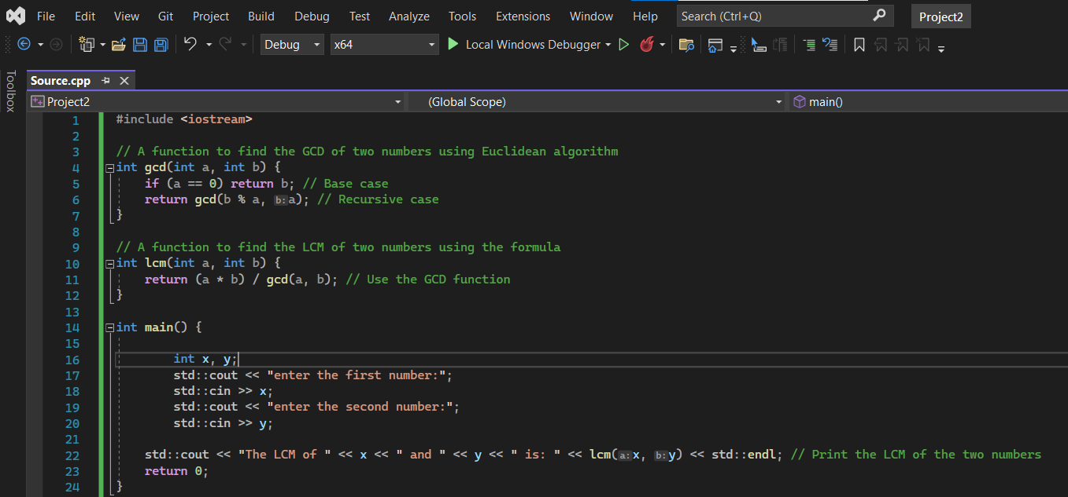
The LCM code and the run

Slide 6
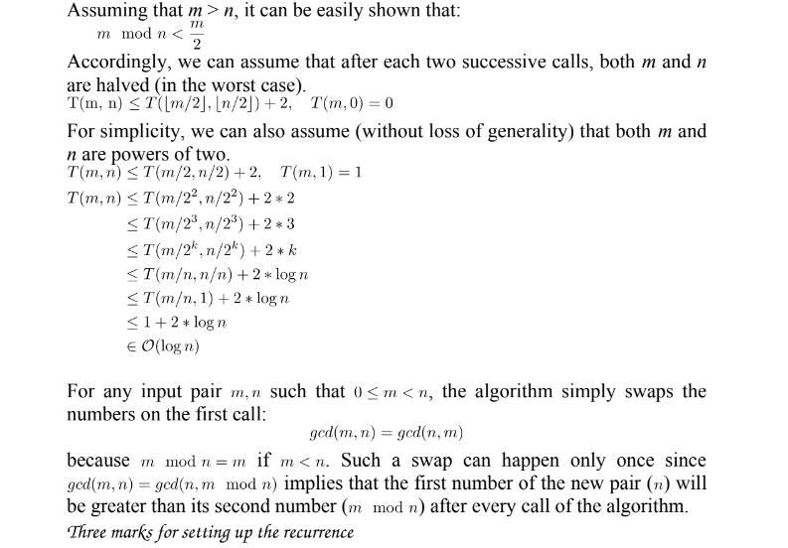
The analysis

Slide 7
Links and References
The video I uploaded on YouTube : https://youtu.be/1jm7KRCRrCY
https://youtu.be/D6yHKOYJiso
https://youtu.be/JUzYl1TYMcU
c++ - Least Common Multiple of given numbers - Stack Overflow

